Slide 1
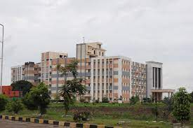

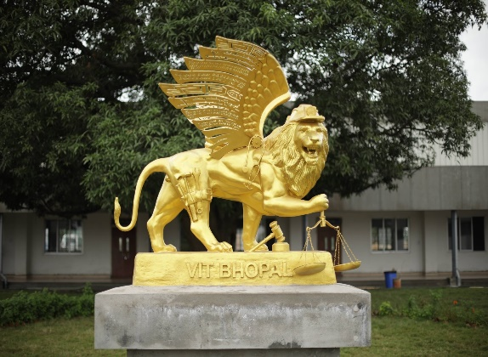

Welcome to
CSA2002 INTRODUCTION TO DRONES
G.GANESAN, B.E (CSE)., M.E (CSE)., M.S(IT).,MISTE.,
SENIOR TEACHING FELLOW,
SCHOOL OF CSE.
+91-9500234437
ganesan.g@vitbhopal.ac.in

Slide 2
Course Objectives
To understand the basics of Unmanned Arial Vehicles
(Drones) and its various applications.
2. To impart the knowledge of how to fly a drone by
considering the rules and regulations to the specific
country
3. To understand the safety measures to be taken during
flight

Slide 3
Course Content
Date: 18-01/2023 Time: 10.05am – 11.35am
Introduction
How Drones Work?
3. Drone Types
4. Overview

Slide 4
Introduction
An unmanned aerial vehicle (UAV), known as a drone,
is an aircraft without a human pilot.
Drone stands for Dynamic Remotely Operated Navigation Equipment.
Its flight is either controlled autonomously by computers or under the remote control of a pilot on the ground.
Balloons, Frisbees, Kites, R/C planes?

Slide 5
Introduction contd…
Key Characteristics
Remote or Autonomous control
Powered
Unmanned
Aerodynamic force for lift
Can carry a Payload¹

Slide 6
Introduction contd…
What is UAS?
An unmanned aerial vehicle (UAV), commonly known as a drone, is an aircraft without a human pilot on board.
Its flight is controlled either autonomously by computers in the vehicle, or under the remote control of a pilot on the ground or in another vehicle.
The term unmanned aircraft system (UAS) emphasizes the importance of other elements beyond an aircraft itself.

Slide 7
Introduction contd…
Other names for UAS
Names that may be used to describe a flying object or machine without a pilot on board aerial torpedo,
radio controlled vehicle
remotely piloted vehicle (RPV)
remote controlled vehicle
autonomous controlled vehicle
pilotless vehicle
unmanned aerial vehicle (UAV)
unmanned aircraft system (UAS)
drone

Slide 8
Introduction contd…
Elements of UAS:
More than just the aircraft
Unmanned aircraft (UA)
Control system, such as ground control system (GCS)
Control link, a specialized
Other related support equipment

Slide 9
Introduction contd…
History:
1800 – Austria attacks Venice with bomb-filled balloons
Minimal efforts during WWI and WWII
Kicked of during Vietnam War, 3400 combat missions³
General John C. Meyer said, “We let the drone do the high-risk flying… the loss rate is high, but we are willing to risk more of them… they save lives!”
As of 2012, the United States Air Force employed 7,44 UAVs – almost 1 in 3 USAF aircraft.

Slide 10
Introduction contd…
History:
2013 – Amazon CEO Jeff Bezos – Use commercial drones for product delivery
July 2016 – Flirtey beat Amazon that it successfully delivered a package to a resident in Nevada using commercial drone.

Slide 11
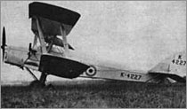
Historical Examples
1. 'Queen' and 'Queen Bee'
1931 the British developed the Fairey 'Queen from a Fairey IIIF floatplane
1935, a larger target was developed that was produced in much larger quantities: the 'DH.82B Queen Bee‘
This led to the designation of the letter “Q” for unmanned aircraft
The term “drone” is said to have originated from the Queen name “bee or drone”
Had wheels or floats depending on launch location
fly at an altitude of 5,182m at speeds of
over 160 km/hr and for up to 482 km

Slide 12
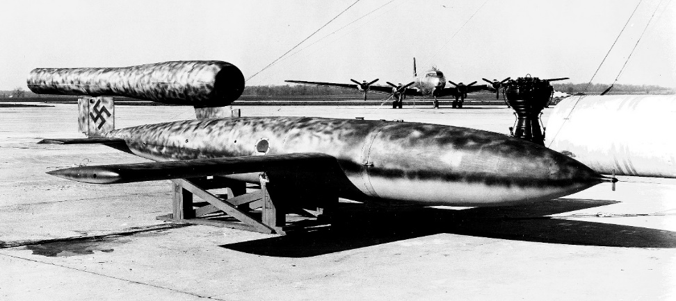
Historical Examples
2. WWII German V-1 Buzz Bomb
Most significant UA of the war
The first mass-produced cruise missile
powered by a primitive yet powerful “pulsejet” engine which gave the V1 a loud noise heard 10 mi away (hence the name)
over 25,000 build
Could be launched both
by air or land
Used a powerful
pneumatic catapult system
Primarily employed from ground-launch rail systems

Slide 13
Introduction contd…
Regulations:
FAA modernization and reform Act of 2012.
Sept’2015 for the agency to establish regulations to allow the use of commercial drones.
August 2013, commercial unmanned aerial system (UAS) licenses were granted on a case-by-case basis, subject to approval by the
Federal Aviation Administration (FAA).
Feb 2015, the FAA announced that up to 7000 businesses could get approval to fly drones under proposed rules by the FAA.

Slide 14
Introduction contd…
What is drone?
A drone is an unmanned aircraft known as Unmanned Aerial Vehicle
(UAV) or Unmanned Aircraft Systems (UAS).
A drone is a flying robot that can be remotely controlled or fly autonomously using software-controlled flight plans in its embedded systems, that work in conjunction with onboard sensors and a Global Positioning System (GPS).

Slide 15
Introduction contd…
UAV are most associated with the military for anti-aircraft target practice, intelligence gathering and a weapons platforms.
In Civilian Roles
Search and Rescue
Surveillance Photography and Videography
Traffic monitoring Delivery services
Weather monitoring
Fire fighting
Agriculture

Slide 16
How Drones Work?
Common Components
Electronic Speed Controller – Motor speed and Direction
Flight Controller
GPS module
Battery Accelerometer – measure speed
Antenna Altimeter – measure altitue
Receiver
Cameras
Sensors including Ultrasonic and collision avoidance

Slide 17
How Drones Work? Contd…
Common Features
Cameras – High performance, zoom, gimbal steady cam and tilt.
AI - enables to follow the Objects
Augmented reality – Superimpose virtual objects
Media storage format Live video feed
Maximum flight time and speeds Flight logs
Hover accuracy
Obstacle sensory range
Altitude hold

Slide 18
How Drones Work? Contd…
Two basic functions:
Flight mode 2. Navigation mode
Important Components to Fly:
Power source – Fuel or Battery
Rotors and Propellers.
Frame – Lightweight with composite material to reduce weight.
Controller – Launch remote, navigate, and land.
Communication – Radio waves (Wi-Fi)

Slide 19
Mission Based Drones
There are 6 types:
1. Combat – Attacking in the high-risk missions are called as Unnamed Combat Aerial Vehicles (UCAV). It carry missiles for the missions.

Slide 20
Mission Based Drones
2. Logistics: Delivering goods or cargo. Amazon and Domino’s.
When traffic on the roads or the route is not easy to drive.

Slide 21
Mission Based Drones
3. Target and Decoy:
It provides the ground and aerial gunnery with a target that
simulates the missile or enemy aircrafts.

Slide 22
Mission Based Drones
4. Research and Development:
Collecting data from the air – Weather / Internet / Intranet
By their Wings or Flying mechanism
5. Rotor – Single, Multiple (Tricopters, Quadcopters, Hexacopters,
and Octocopters.
6. Fixed-Wing – Hybrid vertical takeoff and landing (VTOL) drones
(No runways)

Slide 23
UAS System Overview
The way a pilotless aircraft is controlled determines its categorization
Unmanned Aerial Vehicle (UAV): a pilotless aircraft that is either manually controlled with a joystick or a mouse or autonomously flown by following a preprogrammed mission.
Remotely Piloted Vehicle (RPV): a pilotless aircraft that is steered or controlled from a remotely located position. In many cases, the terms UAV and RPV are interchangeably used to describe any pilotless aircraft.
Drone: one of the oldest terms used to describe a pilotless aircraft. A drone is defined as a pilotless aircraft controlled by radio signal.

Slide 24
Thank You
&
Queries?

